Slide 1


HAND GESTURE CONTROLLED ROBOT
- An insignia in technology

Slide 2

P. SANDEEP
01
S. MOHSIN HUSSAIN
R. SREENITHA
02
03
ASHRITH REDDY
DEEPTHI REDDY
04
05
MEET THE TEAM- ROBOCOPS
208R1A66F9(CSM-C)
208R1A66G8(CSM-C)
208R1A6649(CSM-A)
208R1A66D1(CSM-C)
208R1A66E4(CSM-C)

Slide 3

OUTLINE OF THIS PROJECT
Here’s what you’ll find in this Project Presentation :
INTRODUCTION.
PROJECT DESCRIPTION & OBJECTIVE.
COMPONENTS USED.
CIRCUIT DIAGRAM.
WORKING.
APPLICATIONS
ADVANTAGES.
SUMMARY AND CONCLUSION.

Slide 4

INTRODUCTION
• Gesture Controlled Robotics stands for using body movements as input signals to control the robot dynamics.
• Features are attached to the body parts. These features may themselves be sensors or they may be objects that can be identified using other external sensors like camera.
• Through this method, the user can control or navigate the robot by using gestures of his/her palm, thereby interacting with the robotic system. The command signals are generated from these gestures using image processing. These signals are then passed to the robot to navigate it in the specified directions

Slide 5


OBJECTIVE
“ To build a robot based on hand controlled assist system, developed using an electronic and mechanical arrangement controlled by Programmable Interface Controller. ”

Slide 6
COMPONENTS USED :
AURDINO UNO x 2
________
MOTOR DRIVER
ACCELEROMETER
( L293D )
( ADXL×335 )
________
RECEIVER & TRANSMITTER
VOLTAGE REGULATOR
( RF KIT )
( 7805 )
P.U.B KIT

Slide 7
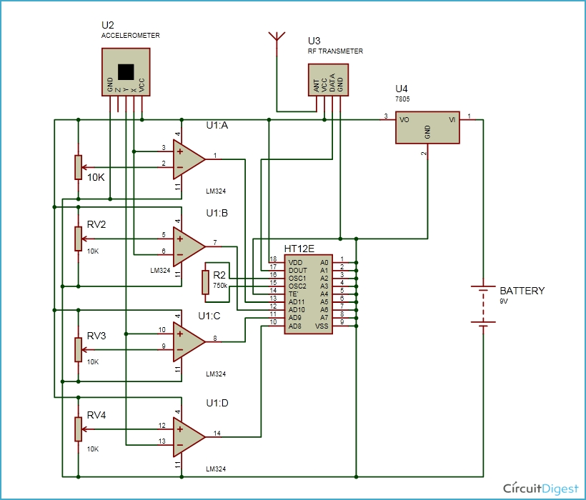
CIRCUIT DIAGRAM FOR TRANSMITTER SECTION

Slide 8
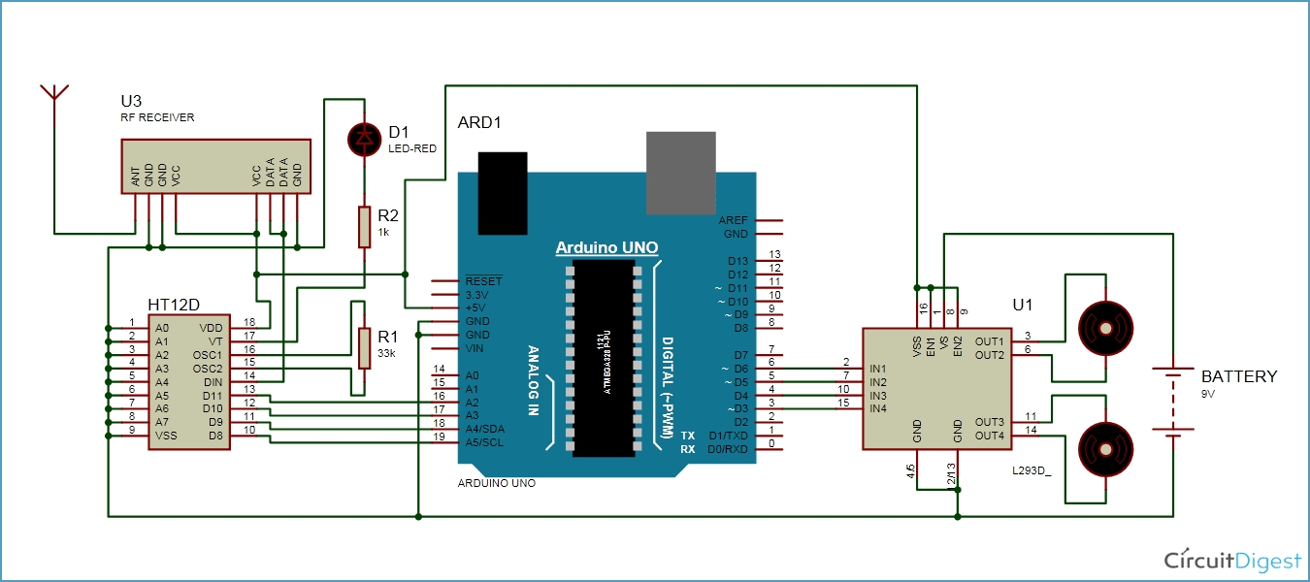
CIRCUIT DIAGRAM FOR RECIEVER SECTION

Slide 9
WORKING
1. Gesture controlled robot moves according to hand movement as we place transmitter in our hand. When we tilt hand in front side, robot start to moving forward and continues moving forward until next command is given. 2. Arduino UNO is used for sending the signals and the other is used for receiving those signals and move the robot accordingly.Accelerometer sensor that can sense the gesture of our hand.
3. The Transmitter sends the signals via Bluetooth module that we use for wireless communication.
4. RF Transmitter is placed along with accelerometer in the user’s hand to transmit a command to a robot so that it can perform the required task.
5. RF Receivers are one of the easiest ways to add wireless control. It receives the data sent by the gesture device whose working is similar to the transmitter

Slide 10
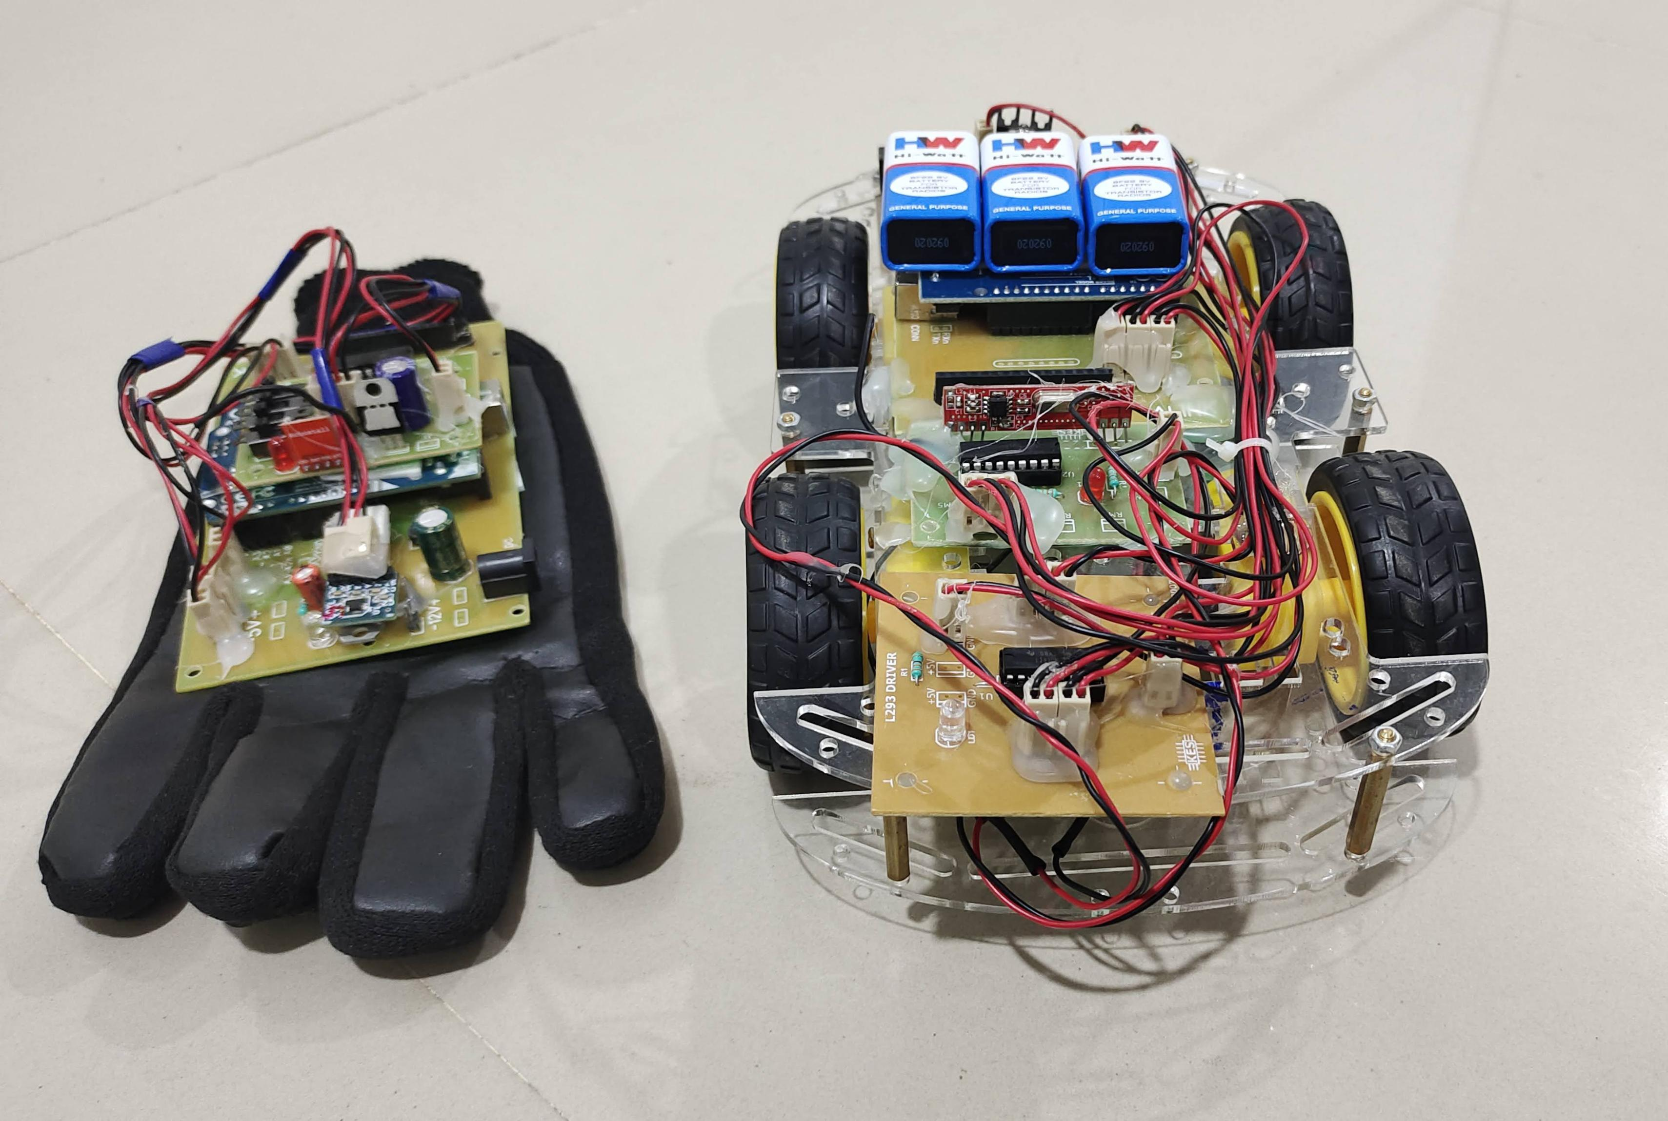
A PICTURE ALWAYS REINFORCES THE CONCEPT

Slide 11
ADVANTAGES:
EASY TO OPERATE
USER FRIENDLY
SINGLE EQUIPMENT = MULTIPLE APPLICATIONS
When extended further in the hardware section, numerous applications can be added
One can able to control one’s slave robots just by hand gestures by this technology.

Slide 12
Applications
Gestures can be used to control interactions for entertainment purposes such as gaming to make the game player’s experience more interactive or immersive.
Through the use of gesture recognition, remote control with the wave of a hand of various devices is possible.
Industrial application for trolley control, lift control, etc.
Can be used as an assistance for physically challenged people..
Medical application for surgery purpose.
Military application to control robotics.

Slide 13
CONCLUSION :
1. In this project we introduced a hand-gesture-based interface for navigating a car-robot.
2. A user can control a car-robot directly by using his or her hand trajectories.
3. In the future, we will directly use a mobile phone with an accelerometer to control a car-robot.
4. We also want to add more hand gestures (such as the curve and slash) into the interface to control the car more naturally and effectively.

Slide 14
THANKS!
Do you have any questions?
shaikmohsinhussain22@gmail.com
+91 6302 264 345
+91 7995 111 503

